Slide 1
Symbolic Execution in Software Engineering
By
Xi Ge
Dayoung Lee
Xusheng Xiao
Towards
Partial fulfillment for Course 707

Slide 2
Overview
Introduction to symbolic execution
Test generation using dynamic symbolic execution
Path explosion problem
NP-complete problem
Greedy algorithm: fitness guided exploration
String constraint solver
Hampi: Context free grammar
Symbolic Grammar
Context free grammar

Slide 3
Symbolic Execution
Symbolic execution is the analysis of programs by tracking symbolic rather than actual values.
Symbolic execution is used to reason about all the inputs that take the same execution path through a program.
int main(int y)
{
y = 2 * y;
if (y == 4){
printf(“y == 4”);
}else {
printf(“y != 4”);
}
}
s
Example:
2 * s
2 * s == 4

Slide 4
Dynamic Symbolic Execution (DSE)
DSE is used to generate test inputs systematically
Choose next path
Solve
Execute&Monitor
void CoverMe(int[] a)
{
if (a == null) return;
if (a.Length > 0)
if (a[0] == 1234567890)
throw new Exception("bug");
}
Constraints to solve
a!=null
a!=null &&
a.Length>0
a!=null &&
a.Length>0 &&
a[0]==123456890
Input
null
{}
{0}
{123…}
Observed constraints
a==null
a!=null &&
!(a.Length>0)
a==null &&
a.Length>0 &&
a[0]!=1234567890
a==null &&
a.Length>0 &&
a[0]==1234567890
a==null
F
T
a.Length>0
Done: There is no path left.
F
T
a[0]==123…
F
T
4
Notes:
4
4
4

Slide 5
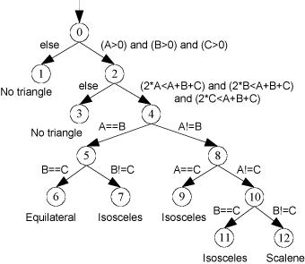
Path Explosion
CFG (control flow graph)
Each program under test could be modeled as CFG.
To achieve 100% path coverage is in NPC.

Slide 6
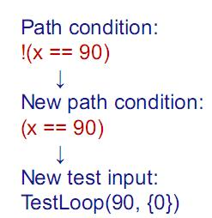
Path Explosion
Public bool TestLoop(int x, int[] y){
if(x==90){
for(int i=0; i<y.length;i++)
if(y[i]==15)
x++;
If(x==110)
return true;
}
return false;
}
TestLoop(0,{0})

Slide 7
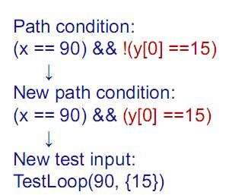
Path Explosion
Public bool TestLoop(int x, int[] y){
if(x==90){
for(int i=0; i<y.length;i++)
if(y[i]==15)
x++;
If(x==110)
return true;
}
return false;
}
TestLoop(90,{0})

Slide 8
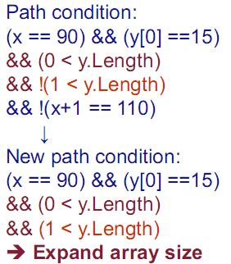
Path Explosion
Public bool TestLoop(int x, int[] y){
if(x==90){
for(int i=0; i<y.length;i++)
if(y[i]==15)
x++;
If(x==110)
return true;
}
return false;
}
TestLoop(90,{15})

Slide 9
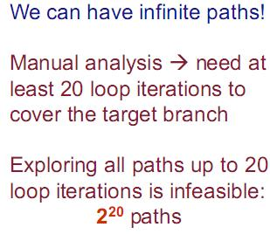
Path Explosion
Public bool TestLoop(int x, int[] y){
if(x==90){
for(int i=0; i<y.length;i++)
if(y[i]==15)
x++;
If(x==110)
return true;
}
return false;
}

Slide 10
Path Explosion
Public bool TestLoop(int x, int[] y){
if(x==90){
for(int i=0; i<y.length;i++)
if(y[i]==15)
x++;
If(x==110)
return true;
}
return false;
}

Slide 11
Fitness
Greedy algorithm: Fitness Guided Explosion
Fitness Function: Measure the current state and the goal state.
Public bool TestLoop(int x, int[] y){
if(x==90){
for(int i=0; i<y.length;i++)
if(y[i]==15)
x++;
If(x==110) Fitness function: |110-x|
return true;
}
return false;
}

Slide 12
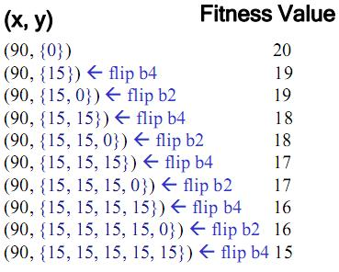
Fitness
Public bool TestLoop(int x, int[] y){
if(x==90){
for(int i=0; i<y.length;i++)
if(y[i]==15)
x++;
If(x==110)
return true;
}
return false;
}

Slide 13
String Constraint Solver
Testing tools could be reduced to constraint generation phase and constraint solving phase.
String constraint solvers are needed by testing string-manipulating programs
Web application
Hampi

Slide 14
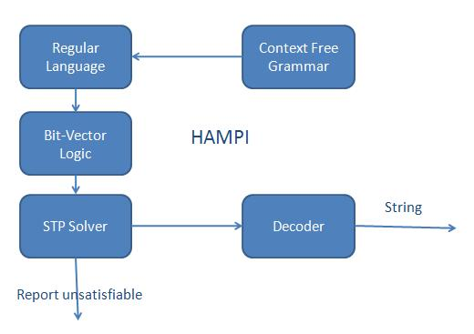
HAMPI

